Slide 1
Machine Learning Project on Car Purchase Prediction
Ferdous, Nahid
Ferdous, Nahid
Members : Nahid Ferdous

Slide 2
Introduction :
Source of Dataset
Used sample recording for building dataset.
Converted audio into text with help of python code
We extracted the features from audio and saved as text.
Objectives/Goal :
Predicting whether a customer will purchase a car based on certain features.

Slide 3



Collect voice data from the customers

Slide 4
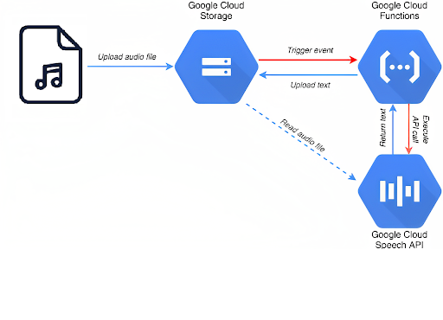
Speech to text conversion
Configure the Google Cloud API
Configure Google Cloud API Account.
Generate a Json key to connect python
code with the Google Cloud API.

Slide 5
Speech to text conversion
Output of the Speech:
“I am a 31-year-old male a landscape photographer searching for a SUV that combines fuel efficiency with space for equipment with a 35000 budget I aim for a vehicle that facilitates my photography Adventures without heavy fuel consumption”

Slide 6
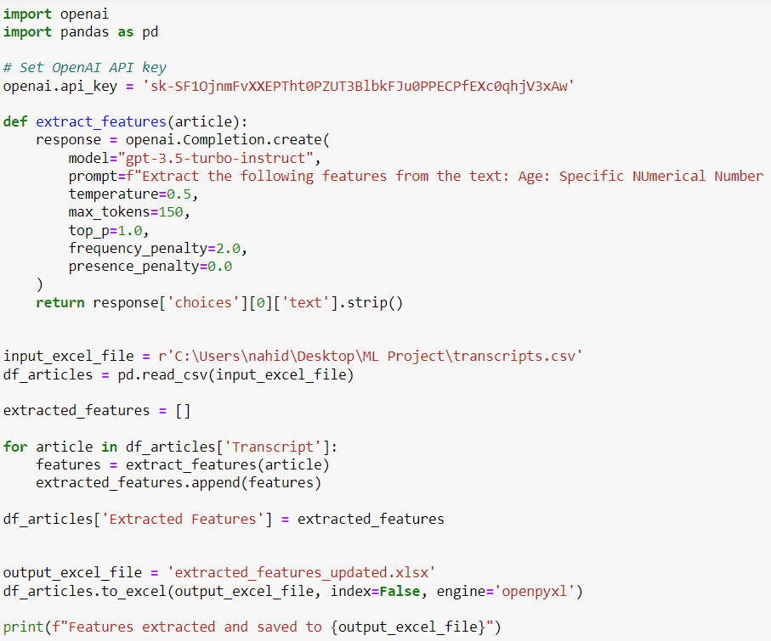

Open AI

Slide 7
GPT 3.5 Turbo
Feature
Feature Extraction of observation 01.
Yes
“'Age: 31\nGender: Male\nPreferred Car Type: Estate car \nFuel Efficiency: Yes \nBudget: $35000’”
Repeat
Repeat this process N number of times. Here N= Total number of observations

Slide 8
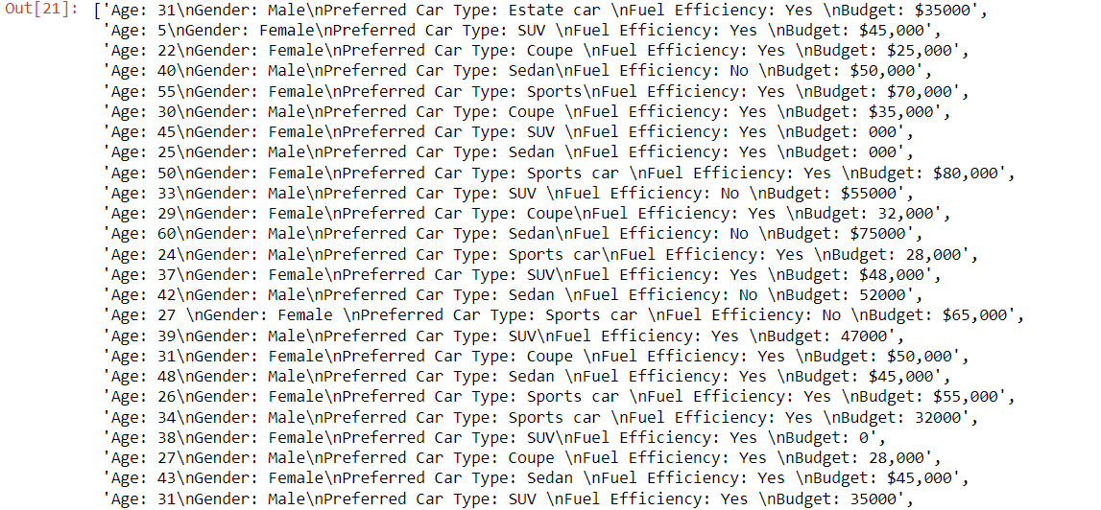
Raw Features or Unstructured Features
Notes:
We have got this dataset from the GPT-3.5 Turbo model. The dataset is not well-formatted for machine learning models. We need to create a structured dataframe for our ML model.

Slide 9
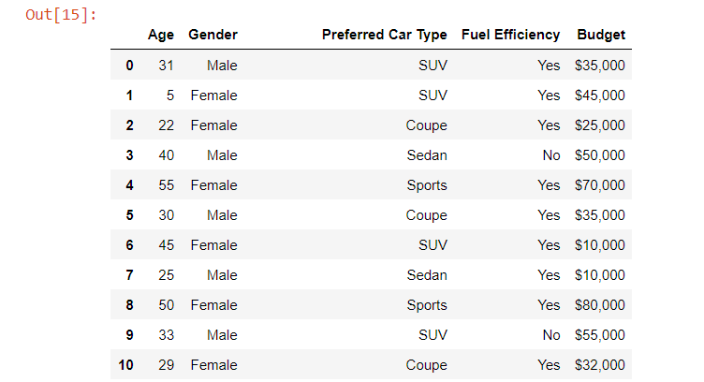
Features are in Structured Format
Notes:
Here, we have used Python code to give the dataset a well-structured format for ML Model

Slide 10

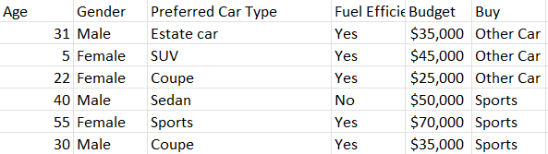
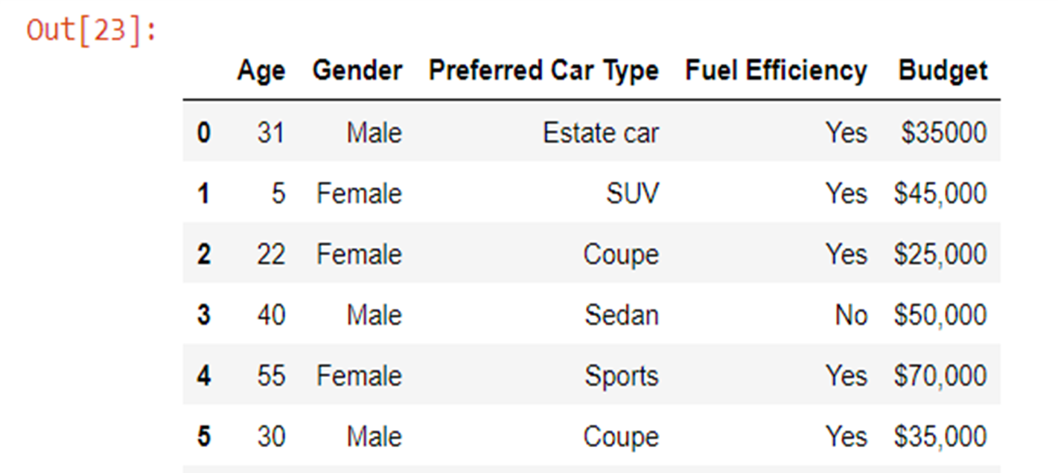
Identify the outcomes
Notes:
Now we have a dataset that contains only the independent features, because we are not dealership sales experts. That's why we have contacted the sales manager at Gilman Subaru dealership, who can accurately identify the outcomes based on his 20 years of sales experience. Gilman Subaru is one of the largest car dealerships in Houston, Texas.

Slide 11
Bootstrapping
Our Original data Size : (6:48) 6 Features and 48 Observation.
After Bootstrapping or up-sampling.
We get (6:1000) 6 Features and 1000 Observations.
By the help of Our Professor Dr. Yuan Jin
Notes:
The dimensions of our original dataset are 5:48, so the 48 observations are not sufficient for ML models. That's why we contacted our professor, Dr. Yuan Jin, and she up-sampled our dataset from 48 observations to 1000 observations.

Slide 12
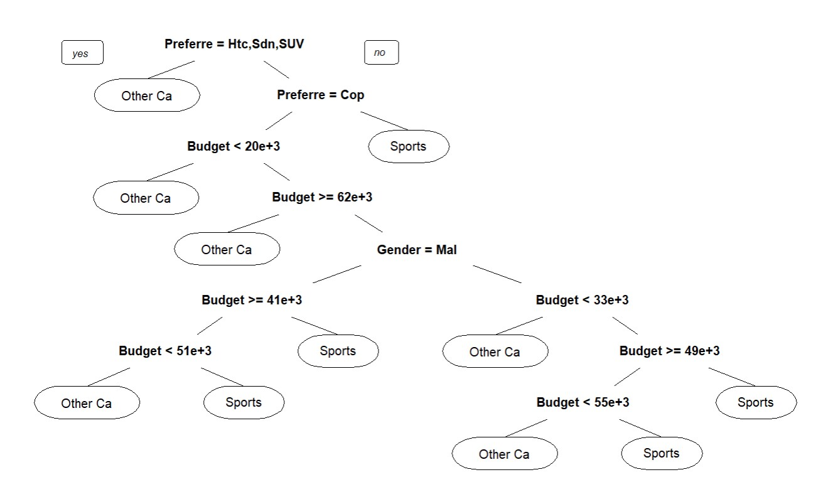
Classification Tree
Notes:
We already know that the outcome of our dataset has 2 categories, so we need to perform classification analysis. That's why we first select a classification tree ML model. After running the model, we get this decision tree. To understand this tree, first, we need to understand concepts like Entropy or Gini impurity and Gain. This model calculates the gain based on entropy and errors. Entropy is calculated from the probability of the variables' categories, and these calculations have specific mathematical equations. Here, our model selects 'Preferred car type' as the initial node, which means the gain of this feature is maximum among the other features. If any node has zero entropy, that means this node is not splitting anymore, and then it will be a leaf. If the Entropy of the node is greater than zero, then it should be split.

Slide 13
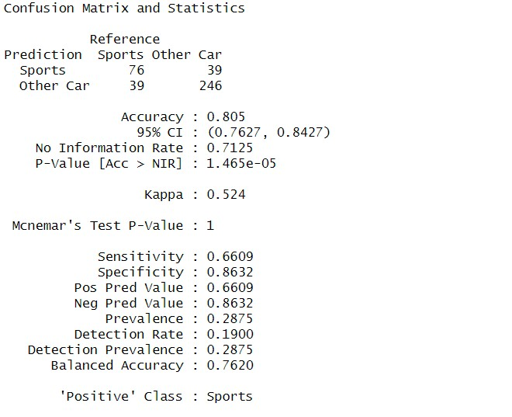
Classification Tree Confusion Matrix
Notes:
From the confusion matrix, we found that the overall accuracy is 80%. In this case, the positive class is 'Sports type car'. The prediction accuracy for the Sports category is 66%, which isn't too bad. Since the p-value is significant, we can accept this model.

Slide 14
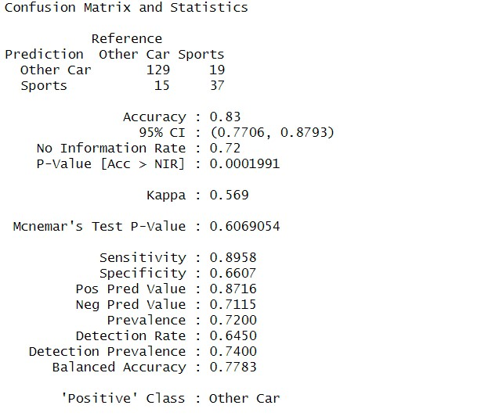
Random Forest
Notes:
From the confusion matrix, we found that the overall accuracy is 80%. In this case, the positive class is 'Sports type car'. The prediction accuracy for the Sports category is 66%, which isn't too bad. Since the p-value is significant, we can accept this model.

Slide 15
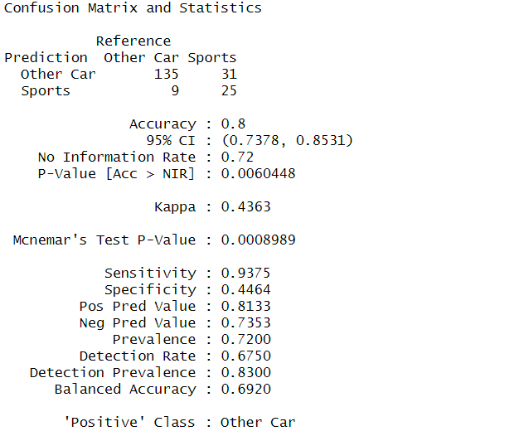
SVM
Notes:
From the confusion matrix, we found that the overall accuracy is 80%. In this case, the positive class is 'Sports type car'. The prediction accuracy for the Sports category is 66%, which isn't too bad. Since the p-value is significant, we can accept this model.

Slide 16
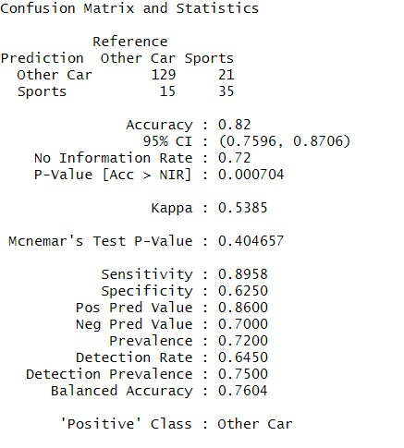
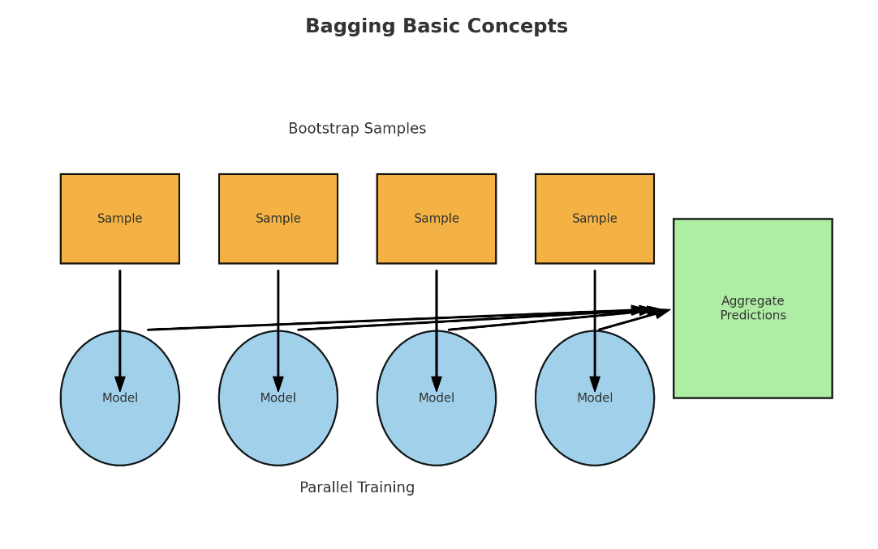
Bagging
Notes:
From the confusion matrix, we found that the overall accuracy is 82%. In this case, the positive class is ‘Other car'. The prediction accuracy for the Sports category is 62.5%, which isn't too bad. Since the p-value is significant, we can accept this model.

Slide 17
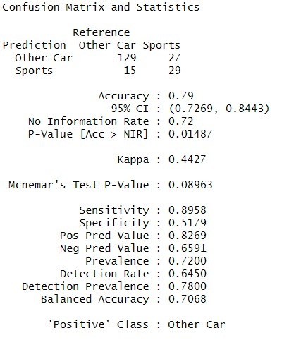
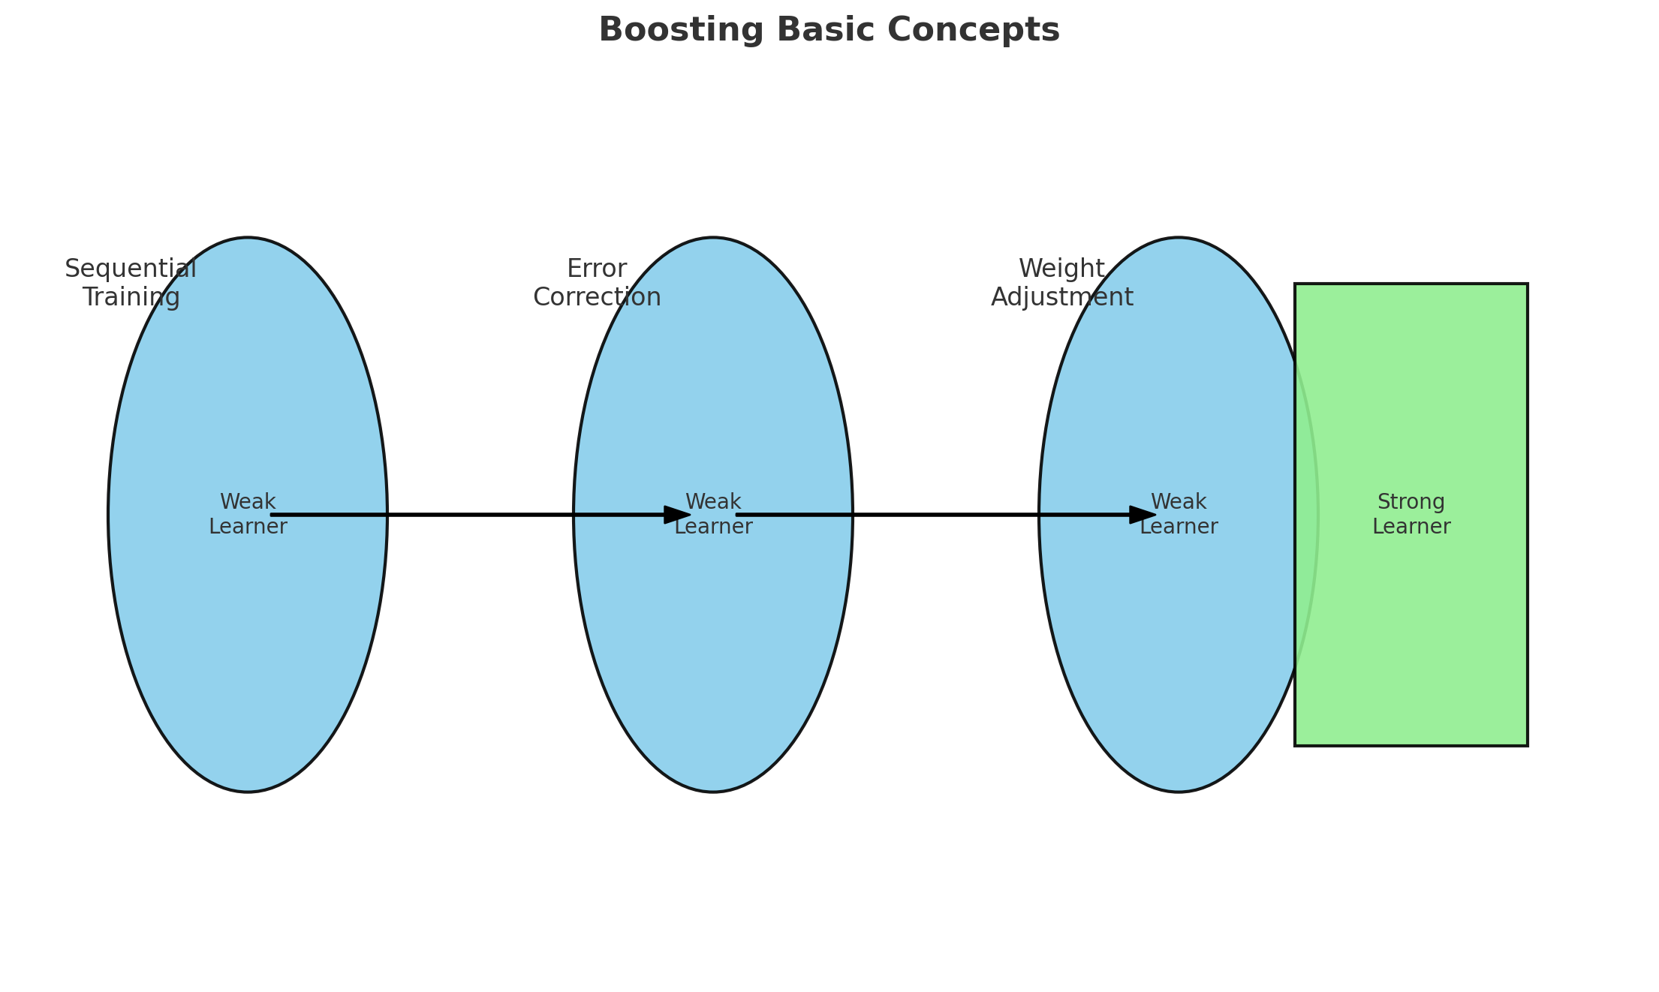
Boosting
Notes:
From the confusion matrix, we found that the overall accuracy is 79%. In this case, the positive class is ‘Other car'. The prediction accuracy for the Sports category is 51%, which is bad. Since the p-value is insignificant, we can reject this model.

Slide 18

Findings :
We tested 5 different ways to predict if a customer will buy a sports car or another type of car. Two methods, called Random Forest and Bagging, were almost equally good at predicting correctly with 83% and 82% success rates. Since Random Forest and Bagging are quite similar, we can choose either one for our project to guess which car a customer will buy.
Even though we talked about choosing cars, this idea could also help doctors make health decisions, or help students choose their college major, by listening to what people say.

Slide 19


